Slide 1





SEC 10K-Filings
Preprocessed Documents
-> Removing HTML-Attributes, Empty HTML Tags, XBLR Tags
Splitted Documents
-> Recursive Character Text Splitter based on HTML (Chunk Length = 6,000 chars; Overlap = 10 %)
Embeddings
-> Snowflake Arctic-embed-m-v1.5
Qdrant Collection
-> Local Docker Instance
Sharing ID
Store Full Documents
-> Right now on Disk, but maybe Database?

Slide 2




Load
Indexing & Retrieval
Qdrant Collection
-> Vectorstore
Load
Document & Table Loader
Questions Doc Loader
Online Data Source
Document Service
Document Splitter
Indexing & Retrieval Service
Write & Load
Embedding API
-> OpenAI, Azure Foundry
Local
Document Store
-> Raw Data
Document Preprocessor
Retrieval
Evaluation
Text Generation Service
Evaluation Service
Table Serializer
QA Evaluation
TabTree
Implementation
TabTree Serializer
HTML
…
Langchain
Pipeline
TabTree
Tests
Context Detection
Chat Completions API
-> OpenAI, Azure Foundry

Slide 3






Enyclopedia
Questions
→ When was Einstein born?
Academic Tests
Domain
Question Format
Queries
→ Which year Einstein born
News
Cloze
→ Einstein was born in __.
Social Media
…
Completion
→ Einstein was born …
Question Answering
Unstructured Text
Semi-structured Text
→ e.g., Tables
Extractive
→ When was Einstein born? 1879 (token 5)
Structured Knowledge
→ e.g., Knowledge Graphs
Answer Format
Multi-choice
→ When was Einstein born? (a) 1879, (b) 1880
Evidence / Context Format
Images
Categorical
→ Was Einstein born in 1880? No
Audio
Freeform
→ When was Einstein born? 1879 (generated)
Language
Video
Conversational
Hybrid
English
Chinese
Multilingual
…

Slide 4

Table QA
Context Domain
Answer Format
Closed-Domain
→ Fixed set of tables as context
Open-Domain
→ Undefined amount of tables + optional: text
Free-Form Answers
→ Dialog-like answers
Closed-Form-Answers
→ Term-level answers like numbers, categories, etc.

Slide 5

Table QA Approaches
Text-to-SQL-Models
Semantic Parsing
Table Encoders
Fine-Tuning
LLMs
TableGPT
TableLlama
Tabular Foundation Models
Seq2SQL
TaPas
TaBERT
TURL
Multi-Stage Approaches
CARTE
Retrieve-Reader-Models
GPT
Llama
GraphOTTER
RAG-Approaches
OTT-QA
Agentic Approaches
=
OpenTab
TableRAG
Closed Domain
→ Single Table as Context
=
TaPERA
Open Domain
→ Multiple Tables + additional Text as Context
LLM-powered Approaches
=
General Purpose
Time

Slide 6




Full Documents
Preprocessed Documents
Transformed Documents
Document Chunking
Chunk Embeddings
Vector Store
Table Extraction
Table Serialization

Slide 7
Full Documents
Preprocessed Documents
Transformed Documents
Document Chunking
Chunk Embeddings
Vector Store
Table Extraction
Table Serialization

Slide 8
Full Documents
Preprocessed Documents
Document Chunking
Chunk Embeddings
Vector Store

Slide 9
Full Documents
Preprocessed Documents
Document Chunking
Chunk Embeddings
Vector Store

Slide 10
Indexing Vanilla RAG
Indexing
Table QA Framework

Slide 11

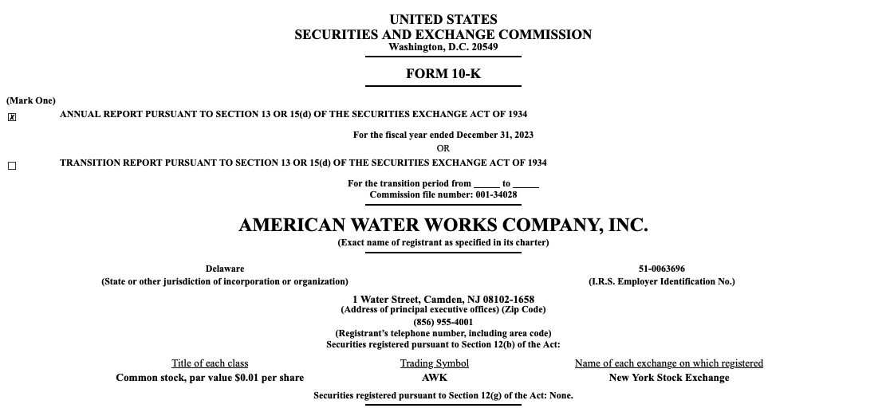
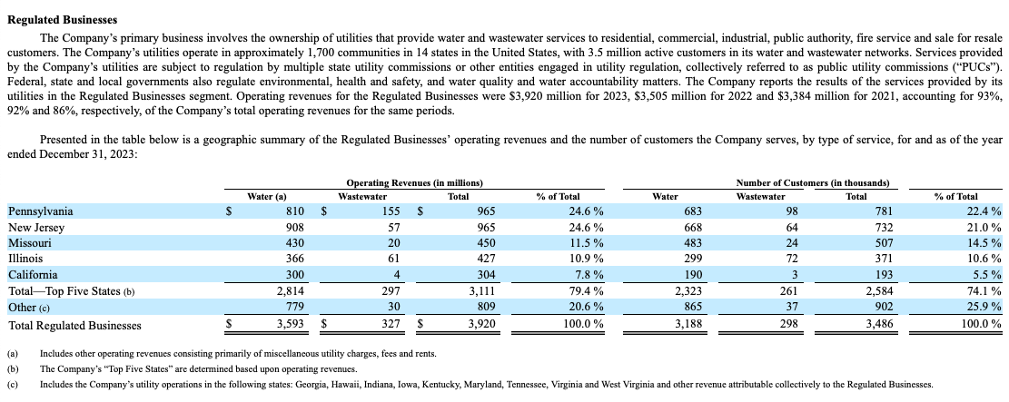
Document Corpus
Unit Elements
…
…

Slide 12

Document Corpus
Relevant Chunk

Slide 13

Question
What is the age of the youngest student?
Document

Slide 14
Document

Slide 15

Serialized Chunk
Question
What is the age of the youngest student?
<table>
<thead>
<tr>
<th colspan="7">grades</th>
</tr>
...
</thead>
<tbody>
...
</tbody>
</table>
Answer
16

Slide 16
Initial Chunk

Slide 17
Relevant Chunk

Slide 18
Relevant Chunk

Slide 19
Question
What is the age of the youngest student?
Chunk Serialization
Answer
16

Slide 20

Question
What is the age of the youngest student in the ‚Science College‘?
Answer
16
Documents
Table QA Framework
Incl. Table Serialization

Slide 21
Question
What is the age of the youngest student?
Chunk
Retrieval
Answer
16

Slide 22
Question
What is the age of the youngest student?
Chunk
Retrieval
Chunk
Serialization
Answer
16

Slide 23
Document
Chunks
…
…
…
…

Slide 24


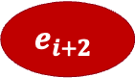


Document
$$e_{1}$$
Text
…
…
$$e_{i}$$
$$e_{i+1}$$
…
…
$$e_{i+2}$$

Slide 25
Table
$$e_{1}$$
Text
…
…
$$e_{i}$$
$$e_{i+1}$$
…
…
$$e_{i+2}$$

Slide 26
j = 1
j = 2
j = 3
j = 4
j = 5
j = 6
j = 7
i = 1
grades
 |  |  | 2023 |  | 2024
class | name | age | math | english | math | english
A | John | 17 | A | C | A | B
 | Tiffany | 16 | B | B | C | B
B | Michael | 17 | D | D | D | D
i = 2
i = 3
i = 4
i = 5
i = 6

Slide 27
Initial Table
j = 1
j = 2
j = 3
j = 4
j = 5
j = 6
j = 7
i = 1
grades
 |  |  | 2023 |  | 2024
class | name | age | math | english | math | english
A | John | 17 | A | C | A | B
 | Tiffany | 16 | B | B | C | B
B | Michael | 17 | D | D | D | D
i = 2
i = 3
i = 4
i = 5
i = 6

Slide 28
j = 1
j = 2
j = 3
j = 4
Column Header Cell
j = 5
j = 6
j = 7
i = 1
grades
 |  |  | 2023 |  | 2024
class | name | age | math | english | math | english
A | John | 17 | A | C | A | B
 | Tiffany | 16 | B | B | C | B
B | Michael | 17 | D | D | D | D
i = 2
i = 3
i = 4
i = 5
i = 6
Context-Intersection Cell
Row Label Cell
Value Cell

Slide 29
j = 1
j = 2
j = 3
j = 4
j = 5
j = 6
j = 7
i = 1
grades |  | grades
 |  |  | 2023 |  | 2024
class | name | age | math | english | math | english
A | John | 17 | A | C | A | B
 | Tiffany | 16 | B | B | C | B
B | Michael | 17 | D | D | D | D
i = 2
i = 3
i = 4
i = 5
i = 6

Slide 30
j = 1
j = 2
j = 3
j = 4
j = 5
j = 6
j = 7
i = 1
grades
 |  |  | 2023 |  | 2024
class | name | age | math | english | math | english
A | John | 17 | A | C | A | B
 | Tiffany | 16 | B | B | C | B
B | Michael | 17 | D | D | D | D
i = 2
i = 3
i = 4
i = 5
i = 6

Slide 31
<table>
<thead>
<tr>
<th colspan="7">grades</th>
</tr>
<tr>
<th></th><th></th><th></th>
<th colspan="2">2023</th>
<th colspan="2">2024</th>
</tr>
<tr>
<th>class</th>...<th>english</th>
</tr>
</thead>
<tbody>
<tr>
<td rowspan="2">A</td>
<td>John</td>
...
<td>B</td>
</tr>
...
</tbody>
</table>
grades
 |  |  | 2023 |  | 2024
class | name | age | math | english | math | english
A | John | 17 | A | C | A | B
 | Tiffany | 16 | B | B | C | B
B | Michael | 17 | D | D | D | D

Slide 32
2D-Visual Representation
1D-HTML Representation
grades
 |  |  | 2023 |  | 2024
class | name | age | math | english | math | english
A | John | 17 | A | C | A | B
 | Tiffany | 16 | B | B | C | B
B | Michael | 17 | D | D | D | D
<table><tr><th colspan="2">grades</th><th colspan="2“>2023</th><th colspan="2">2024</th> </tr><tr><th>class</th><th>name</th><th>age</th><th>math</th><th>english</th><th>math</th><th>english</th></tr><tr><td>A</td><td>John</td><td>17</td><td>A</td><td>C</td><td>A</td><td>B</td></tr><tr><td>A</td><td>Tiffany</td><td>16</td><td>B</td><td>B</td><td>C</td><td>B</td></tr><tr><td>B</td><td>Michael</td><td>17</td><td>D</td><td>D</td><td>D</td><td>D</td></tr></table>

Slide 33
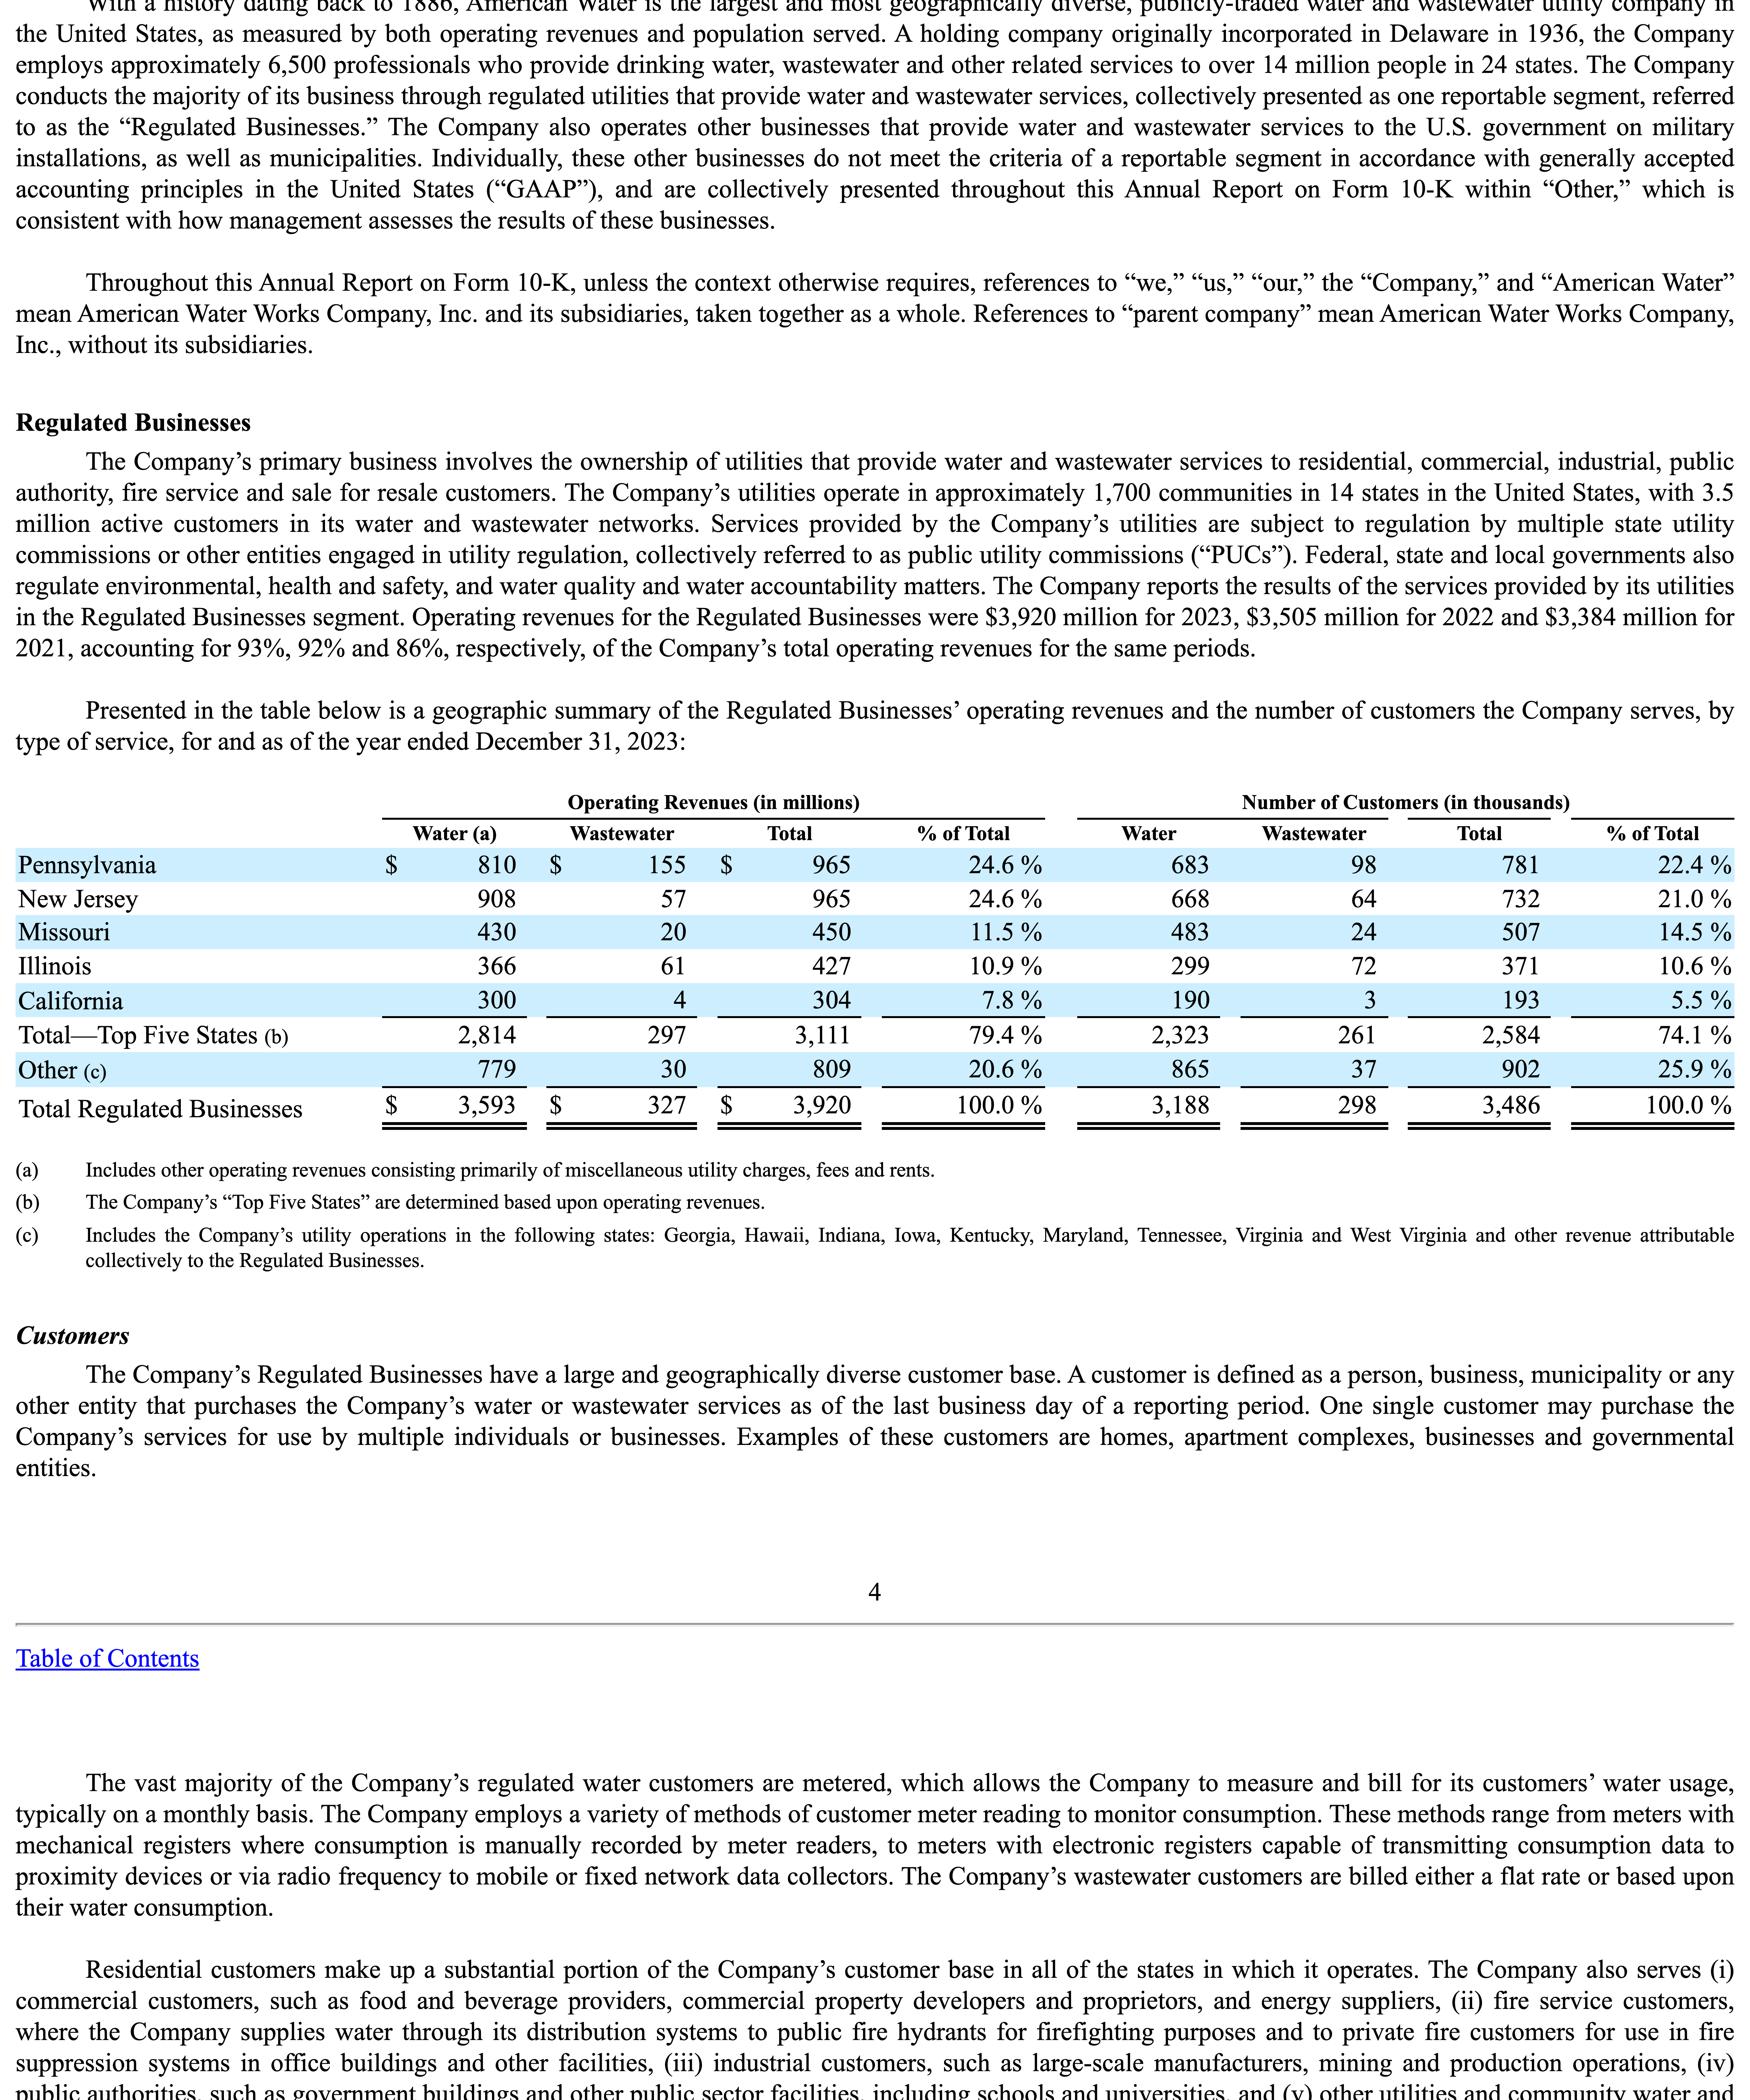

Slide 35
Full Table
1-Range
2-Range
You are tasked with analyzing table data to determine whether the provided row should be classified as a column header or not.
Instructions:
…
Row to analyze:
[‘class’, ‘name’, ‘age’, ‘math’, ‘english’, ‘math’, ‘english’]
The full table is the following:
<table>
<thead>
<tr>
<th colspan="7">grades</th>
</tr>
...
</table>
You are tasked with analyzing table data to determine whether the provided row should be classified as a column header or not.
Instructions:
…
Row to analyze:
[‘class’, ‘name’, ‘age’, ‘math’, ‘english’, ‘math’, ‘english’]
The previous row is the following:
[‘’,’’,’’,’2023’,’2023’,’2024’,’2024’]
The next row is the following:
[‘A’,’John’,’17’,’age’,’A’,’C’,’A’,’B’]
You are tasked with analyzing table data to determine whether the provided row should be classified as a column header or not.
Instructions:
…
Row to analyze:
[‘class’, ‘name’, ‘age’, ‘math’, ‘english’, ‘math’, ‘english’]
The previous row is the following:
[‘’,’’,’’,’2023’,’2023’,’2024’,’2024’]
The second previous row is the following:
[‘grades’,‘grades’, ..., ‘grades’]
The next row is the following:
[‘A’,’John’,’17’,’A’,’C’,’A’,’B’]
The second next row is the following:
[‘A’,’Tiffany’,’16’,’B’,’B’,’C’,’B’]

Slide 36
Column Header Tree as Primary Subtree
Row Label Tree as Primary Subtree
grades:
age:
- A > John: 17
- A > Tiffany: 16
- B > Michael: 17
2023:
math:
- A > John: A
- A > Tiffany: B
- B > Michael: D
english:
- A > John: C
- A > Tiffany: B
- B > Michael: D
2024:
math:
...
english:
...
A:
John:
grades > age: 17
grades > 2023 > math: A
grades > 2023 > english: C
grades > 2024 > math: A
grades > 2024 > english: B
Tiffany:
grades > age: 17
grades > 2023 > math: B
grades > 2023 > english: B
...
B:
Michael:
grades > age: 17
grades > 2023 > math: D
grades > 2023 > english: D
...

Slide 37

$${root}^{c}$$
grades
grades
2023
2024
class
name
age
math
english
math
english
17
16
17
A
B
D
C
B
D
A
C
D
B
B
D

Slide 38
$${root}^{c}$$
grades
grades
2023
2024
class
name
age
math
english
math
english
17
16
17
A
B
D
C
B
D
A
C
D
B
B
D

Slide 39
$${root}^{c}$$
grades
grades
2023
2024
class
name
age
math
english
math
english

Slide 40

$${root}^{r}$$
class
A
B
grades
name
John
Tiffany
Michael
17
16
17
A
B
D
C
B
D
A
C
D
B
B
D

Slide 41
$${root}^{r}$$
class
A
B
grades
name
John
Tiffany
Michael
17
16
17
A
B
D
C
B
D
A
C
D
B
B
D

Slide 42

$${root}^{r}$$
class
A
B
grades
name
John
Tiffany
Michael

Slide 43
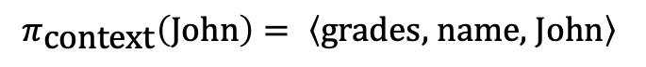
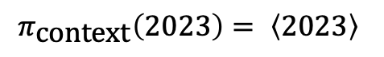
Column Header Tree as Primary Subtree
Row Label Tree as Primary Subtree
$$π_{\text{context}}\left(2023\right)= \left\langle 2023\right\rangle$$
$$π_{\text{context}}\left(\text{John}\right)= \left\langle \text{grades}\text{, }\text{name}\text{, }\text{John}\right\rangle$$

Slide 44
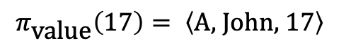
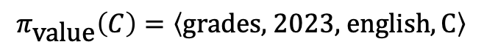
Column Header Tree as Secondary Subtree
Row Label Tree as Secondary Subtree
$$π_{\text{value}}\left(C\right)=\left\langle \text{grades}\text{, 2023, }\text{english},\text{C}\right\rangle$$
$$π_{\text{value}}\left(\text{17}\right)= \left\langle \text{A}\text{, }\text{John}\text{, }17\right\rangle$$

Slide 45
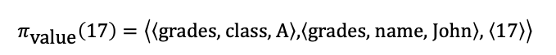
Column Header Tree as Secondary Subtree
Row Label Tree as Secondary Subtree
$$π_{\text{value}}\left(C\right)=\left\langle \left\langle \text{grades}\right\rangle \text{, }\left\langle \text{2023}\right\rangle \text{, }\left\langle \text{class}\text{, }\text{name}\text{, }\text{english}\right\rangle ,\left\langle \text{C}\right\rangle \right\rangle$$
$$π_{\text{value}}\left(\text{17}\right)=\left\langle \left\langle \text{grades}\text{, }\text{class}\text{, }\text{A}\right\rangle \text{,}\left\langle \text{grades}\text{, }\text{name}\text{, }\text{John}\right\rangle \text{, }\left\langle 17\right\rangle \right\rangle$$

Slide 46


${ T}_{1}$ |
Column Header Tree as Primary Subtree
Context String
Base:
2023:
The column header 2023 has siblings 2024. The children of 2023 are math, english.
Text-Augmentation:
${ T}_{1}$ |
Row Label Tree as Primary Subtree
Context String
Base:
John:
The row label John has siblings Tiffany.
Text-Augmentation:

Slide 47


${ T}_{1}$ |
Column Header Tree as Primary Subtree
Context String
Base:
2023:
The column header 2023 has siblings 2024. The children of 2023 are math, english.
Text-Augmentation:
${ T}_{1}$ |
Row Label Tree as Primary Subtree
Context String
Base:
grades & name & John:
The row label John represents grades, names. It has the siblings Tiffany. The values of John are:
Text-Augmentation:

Slide 48
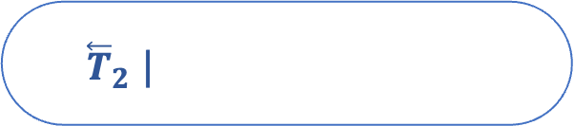

${ \overset{⃖}{T}}_{2}$ |
Column Header Tree as Secondary Subtree
Value String
Base:
grades > 2023 > english: C
The value of the column header combination grades, 2023, english is C.
Text:
The value of the column header combination grades, 2023, english and the row label combination A, John is C.
Text-Augmentation:
${ \overset{⃖}{T}}_{2}$ |
Row Label Tree as Secondary Subtree
Value String
Base:
A > John: 17
The value of the row label combination A, John is 17.
Text:
The value of the row label combination A, John and the column header combination grades, age is 17.
Text-Augmentation:

Slide 49
${ \overset{⃖}{T}}_{2}$ |
Column Header Tree as Secondary Subtree
Value String
Base:
grades > 2023 > class & name & english: C
The value of the column header combination grades, 2023, class & name & english is C.
Text:
The value of the column header combination grades, 2023, class & name & english and the row label combination grades & class & A, grades & name & John is C.
Text-Augmentation:
${ \overset{⃖}{T}}_{2}$ |
Row Label Tree as Secondary Subtree
Value String
Base:
grades & class & A > grades & name & John: 17
The value of the row label combination grades & class & A, grades & name & John is 17.
Text:
The value of the row label combination grades & class & A, grades & name & John and the column header combination grades, class & name & age is 17.
Text-Augmentation:

Slide 50


$${root}^{r}$$
class
A
B
grades
name
John
Tiffany
Michael
17
16
17
A
B
D
C
B
D
A
C
D
B
B
D
age
grades
$${root}^{c}$$

Slide 51

$${root}^{r}$$
class
A
B
grades
name
John
Tiffany
Michael
17
16
17
A
B
D
C
B
D
A
C
D
B
B
D

Slide 52
$${root}^{r}$$
class
A
B
grades
name
John
Tiffany
Michael
17
16
17
A
B
D
C
B
D
A
C
D
B
B
D

Slide 53
$${root}^{r}$$
class
A
B
grades
name
John
Tiffany
Michael
17
16
17
A
B
D
C
B
D
A
C
D
B
B
D
age
grades
$${root}^{c}$$

Slide 54


$${root}^{c}$$
grades
grades
2023
2024
class
name
age
math
english
math
english
17
16
17
A
B
D
C
B
D
A
C
D
B
B
D
John
A
$${root}^{r}$$

Slide 55

$${root}^{c}$$
grades
grades
2023
2024
class
name
age
math
english
math
english
17
16
17
A
B
D
C
B
D
A
C
D
B
B
D

Slide 56
$${root}^{c}$$
grades
grades
2023
2024
class
name
age
math
english
math
english
17
16
17
A
B
D
C
B
D
A
C
D
B
B
D

Slide 57
$${root}^{c}$$
grades
grades
2023
2024
class
name
age
math
english
math
english
17
16
17
A
B
D
C
B
D
A
C
D
B
B
D
John
A
$${root}^{r}$$

Slide 58
<table>
<thead>
<tr>
<th colspan="7">grades</th>
</tr>
...
</thead>
<tbody>
...
</tbody>
</table>

Slide 59
grades
 |  |  | 2023 |  | 2024
class | name | age | math | english | math | english
A | John | 17 | A | C | A | B
 | Tiffany | 16 | B | B | C | B
class | name | age | french | physics | french | physics
B | Michael | 17 | D | D | D | D

Slide 60
grades
 |  |  | 2023 |  | 2024
class | name | age | math | english | math | english
A | John | 17 | A | C | A | B
 | Tiffany | 16 | B | B | C | B
class | name | age | math | english | math | english
B | Michael | 17 | D | D | D | D

Slide 61
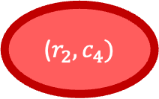
j = 1
j = 2
j = 3
j = 4
j = 5
j = 6
j = 7
i = 1
grades
 |  |  | 2023 |  | 2024
class | name | age | math | english | math | english
A | John | 17 | A | C | A | B
 | Tiffany | 16 | B | B | C | B
B | Michael | 17 | D | D | D | D
i = 2
i = 3
i = 4
i = 5
i = 6
($r_{2},c_{4})$

Slide 62
j = 1
j = 2
j = 3
j = 4
j = 5
j = 6
j = 7
i = 1
grades
 |  |  | 2023 |  | 2024
class | name | age | math | english | math | english
A | John | 17 | A | C | A | B
 | Tiffany | 16 | B | B | C | B
B | Michael | 17 | D | D | D | D
i = 2
i = 3
i = 4
i = 5
i = 6

Slide 63
j = 1
j = 2
j = 3
j = 4
j = 5
j = 6
j = 7
i = 1
grades | grades
 |  |  | 2023 |  | 2024
class | name | age | math | english | math | english
A | John | 17 | A | C | A | B
 | Tiffany | 16 | B | B | C | B
B | Michael | 17 | D | D | D | D
i = 2
i = 3
i = 4
i = 5
i = 6

Slide 64
j = 1
j = 2
j = 3
j = 4
j = 5
j = 6
j = 7
i = 1
grades | grades
 |  |  | 2023 |  | 2024
class | name | age | math | english | math | english
A | John | 17 | A | C | A | B
 | Tiffany | 16 | B | B | C | B
B | Michael | 17 | D | D | D | D
i = 2
i = 3
i = 4
i = 5
i = 6

Slide 65



Split at
$$j^{∗}=2$$
${\tilde{y}}_{14}=(\left[1, 3\right], \left[0, 0\right],“grades“)$ before: $y_{14}=(\left[3, 3\right], \left[0, 0\right],“grades“)$
${\tilde{y}}_{11}=(\left[0, 1\right], \left[0, 0\right],“grades“)$ before: $y_{11}=(\left[0, 6\right], \left[0, 0\right],“grades“)$

Slide 66
Column Headers
Row Labels

Slide 67
grades |  | grades
 |  |  | 2023 |  | 2024
class | name | age | math | english | math | english
A | John | 17 | A | C | A | B
 | Tiffany | 16 | B | B | C | B
B | Michael | 17 | D | D | D | D

Slide 68


$${root}^{c}$$
grades
grades
2023
2024
class
name
age
math
english
math
english
John
Tiffany
Michael
17
16
17
A
B
D
C
B
D
A
C
D
B
B
D
A
B
$${root}^{r}$$

Slide 69

$${root}^{context−inter}$$
grades
grades
2023
2024
A
class
B
name
age
math
english
math
english

Slide 70
$${root}^{context−inter}$$
grades
grades
2023
2024
A
class
name
age
math
english
math
english
B
John
Tiffany
Michael

Slide 71
grades
class

Slide 72

$${root}^{r}$$
A
B
John
Tiffany
Michael
17
16
17
A
B
D
C
B
D
A
C
D
B
B
D

Slide 73
$${root}^{c}$$
grades
2023
2024
name
age
math
english
math
english
John
Tiffany
Michael
17
16
17
A
B
D
C
B
D
A
C
D
B
B
D

Slide 74
Column Header Tree
Row Label Tree

Slide 76
HTML Table
TabTree Model
Table Serialization

Slide 77

DFS-based Serialized String
TabTree Model
Modular System
Base
Context String Generation Approach
Text-Augmentation
Base
Value String Approach
Text
Text-Augmentation
Column Header 1st
Primary Subtree Selection
Row Label 1st
Concatenation
Heuristic

Slide 78


$${root}^{c}$$
grades
grades
2023
2024
class
name
age
math
english
math
english
17
16
17
A
B
D
C
B
D
A
C
D
B
B
D
name
John
Tiffany
Michael
grades
class
A
B
$${root}^{r}$$

Slide 79
$${root}^{c}$$
grades
grades
2023
2024
class
name
age
math
english
math
english
17
16
17
A
B
D
C
B
D
A
C
D
B
B
D
name
John
Tiffany
Michael
grades
class
A
B
$${root}^{r}$$

Slide 80

$${root}^{c}$$
grades
grades
2023
2024
class
name
age
math
english
math
english
17
16
17
A
B
D
C
B
D
A
C
D
B
B
D
John
Tiffany
Michael
A
B
$${root}^{r}$$

Slide 81

$${root}^{c}$$
grades
grades
2023
2024
class
name
age
math
english
math
english
17
16
17
A
B
D
C
B
D
A
C
D
B
B
D

Slide 82

$${root}^{r}$$
class
A
B
grades
name
John
Tiffany
Michael
17
16
17
A
B
D
C
B
D
A
C
D
B
B
D

Slide 83
$${root}^{c}$$
grades
2023
2024
age
math
english
math
english
17
16
17
A
B
D
A
B
D
A
C
D
B
B
D
A
B
$${root}^{r}$$

Slide 85
j = 1
j = 2
j = 3
j = 4
j = 5
j = 6
j = 7
i = 1
grades
 |  |  | 2023 |  | 2024
class | name | age | math | english | math | english
A | John | 17 | A | C | A | B
 | Tiffany | 16 | B | B | C | B
B | Michael | 17 | D | D | D | D
i = 2
i = 3
i = 4
i = 5
i = 6

Slide 86


j = 1
j = 2
j = 3
j = 4
j = 5
j = 6
j = 7
i = 1
grades
 |  |  | 2023 |  | 2024
class | name | age | math | english | math | english
A | John | 17 | A | C | A | B
 | Tiffany | 16 | B | B | C | B
B | Michael | 17 | D | D | D | D
i = 2
i = 3
i = 4
i = 5
$γ_{24}=(\left[0, 1\right], \left[0,0\right],“2023“)$
i = 6
j = 1
j = 2
j = 3
j = 4
j = 5
j = 6
j = 7
i = 1
$γ_{51}=(\left[0, 0\right], \left[1,0\right],“A“)$
grades
 |  |  | 2023 |  | 2024
class | name | age | math | english | math | english
A | John | 17 | A | C | A | B
 | Tiffany | 16 | B | B | C | B
B | Michael | 17 | D | D | D | D
i = 2
i = 3
i = 4
i = 5
i = 6

Slide 87


j = 1
j = 2
j = 3
j = 4
j = 5
j = 6
j = 7
j = 1
j = 2
j = 3
j = 4
j = 5
j = 6
j = 7
i = 1
grades
 |  |  | 2023 |  | 2024
class | name | age | math | english | math | english
A | John | 17 | A | C | A | B
 | Tiffany | 16 | B | B | C | B
B | Michael | 17 | D | D | D | D
i = 1
$γ_{51}=(\left[0, 0\right], \left[1,0\right],“A“)$
grades
 |  |  | 2023 |  | 2024
class | name | age | math | english | math | english
A | John | 17 | A | C | A | B
 | Tiffany | 16 | B | B | C | B
B | Michael | 17 | D | D | D | D
i = 2
i = 2
i = 3
i = 3
i = 4
i = 4
i = 5
$γ_{24}=(\left[0, 1\right], \left[0,0\right],“2023“)$
i = 5
i = 6
i = 6

Slide 88

j = 1
j = 2
j = 3
j = 4
j = 5
j = 6
j = 7
i = 1
grades
 |  |  | 2023 |  | 2024
class | name | age | math | english | math | english
A | John | 17 | A | C | A | B
 | Tiffany | 16 | B | B | C | B
B | Michael | 17 | D | D | D | D
i = 2
i = 3
i = 4
i = 5
$γ_{24}=(2, 2, \left[0, 1\right], \left[1,0\right],“2023“)$
i = 6

Slide 89




Qdrant Collection
Most Relevant Full Documents
Question
Query Embedding
Top-K Chunks
-> Similar to Document Embeddings: Snowflake Arctic-embed-m-v1.5
-> Distance Metric: Cosine Similarity
Query
Context
Prompt
You are tasked with answering questions based on specific financial documents. Your task is to give the correct answer based on the given context. Respond with only the answer. Do not include words like "Answer" or "Response." Provide the answer as either:
- A number for questions about revenue, profit, or quantities.
- A word or phrase for questions about products, categories, or names.
- 'None' if the context doesn't provide information about the given question.
[…]
Example:
- What was the sales revenue of Company Y from 2022 to 2024?
2,500
[…]
Context: \n {context}
Question: \n {question}
LLM
-> Huggingface Inference API - mistralai/Mistral-Nemo-Instruct-2407
Evaluation
Answer
-> Accuracy, F1 Score

Slide 90
Question / Query
Query Embedding
Vector Store
Top-K Chunks
Similarity Metric
Query
Context
Prompt
LLM
Answer
Evaluation

Slide 91
Question / Query
External Data Source
Query
Query
Additional Information
Prompt
LLM
Answer

Slide 92
Question / Query
Query Embedding
Vector Store
Top-K Chunks
Similarity Metric
Query
Context
Prompt
LLM
Answer
Evaluation

Slide 93
Question / Query
Query Embedding
Vector Store
Top-K Chunks
Similarity
Search

Slide 94
Retrieval & Text Generation
Vanilla RAG
Retrieval & Text Generation
Table QA Framework

Slide 95
<table>
<tr>
<tr>
<tr>
<tr>
…
Operating Revenues
Other
Total Regulated Businesses
$
Water
779
3,593
$
Wastewater
30
327
$
Total
809
3,920
$
% of Total
20.6
%
100.0
%

Slide 96
<table>
<tr>
<tr>
<tr>
<tr>
…
Operating Revenues
Other
Total Regulated Businesses
$
Water
779
3,593
$
Wastewater
30
327
$
Total
809
3,920
$
% of Total
20.6
%
100.0
%

Slide 97
<table>
Operating Revenue (in mio.)
Water
Wastewater
Total
% of Total
Pennsylvania: 810
Pennsylvania: 155
Pennsylvania: 965
Pennsylvania: 24.6
…
…
…
…
New Jersey: 908
New Jersey: 57
New Jersey: 965
New Jersey: 24.6
Total Regulated Business: 3,593
Total Regulated Business: 327
Total Regulated Business: 3,920
Total Regulated Business: 100

Slide 98
<table>
name
John C. Griffith
Melanie M. Kennedy
Cheryl Norton
age: 57
age: 50
age: 59
office: CFO
office: CHRO
office: COO

Slide 100
<table>
<tr>
<tr>
<tr>
<tr>
…
Operating Revenues
Other
Total Regulated Businesses
$
Operating Revenues
Operating Revenues
Water
Water
779
3,593
$
Operating Revenues
Operating Revenues
Wastewater
Wastewater
30
327
$
Operating Revenues
Operating Revenues
Total
Total
809
3,920
$
Operating Revenues
Operating Revenues
% of Total
% of Total
20.6
%
100.0
%

Slide 101
<table>
How much was the total regulated business revenue of American Water Works in 2023 for the wastewater sector?
<tr>
<tr>
<tr>
<tr>
…
Operating Revenues
Other
Total Regulated Businesses
$
Operating Revenues
Operating Revenues
Water
Water
779
3,593
$
Operating Revenues
Operating Revenues
Wastewater
Wastewater
30
327
$
Operating Revenues
Operating Revenues
Total
Total
809
3,920
$
Operating Revenues
Operating Revenues
% of Total
% of Total
20.6
%
100.0
%

Slide 102
<table>
How much was the total regulated business revenue of American Water Works in 2023 for the wastewater sector?
<tr>
<tr>
<tr>
<tr>
…
Operating Revenues
Other
Total Regulated Businesses
$
Water
779
3,593
$
Wastewater
30
327
$
Total
809
3,920
$
% of Total
20.6
%
100.0
%

Slide 103
<table>
<col>
<col>
<col>
<col>
…
Pennsylvania
New Jersey
$
$
Other
779
Total Regulated Businesses
$
Missouri
Illinois
30
809
3,593
$
California
Total Top 5
20.6
%
327
$
Other
Total Regulated Businesses
3,920
$
100.0
%

Slide 104
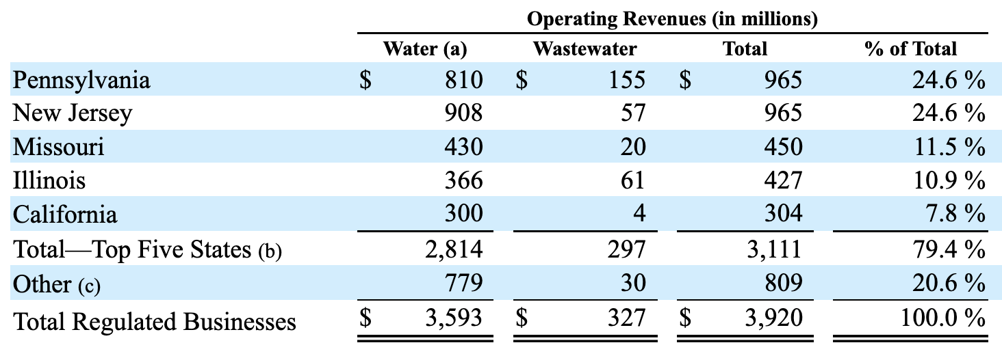
No thead tags in HTML
Multi-line headers
No HTML structure for column index
Semantically different table structures
(e.g., transposed tables)

Slide 105
Prompt
You are tasked with analyzing table data to determine whether the provided row should be classified as a header or not.
Instructions:
1. Review the provided row and the next and previous rows.
2. Consider typical properties of a header row when making your determination. For header rows typically yield (…)
3. End your response with one of the following:
- "Answer: Yes" if the row represents a header row.
- "Answer: No" if the row contains actual records or entries (e.g., numerical values, measurements, metrics or attributes corresponding to a category).
4. Reason your answer with maximum 150 tokens.
Row to analyze:
['A', 'John', '17', 'A', 'C', 'A', 'B', ’’]
The row index of the provided row is 3.
The previous row looks like this: ['class', 'name', 'age', 'math', 'english', 'math', 'english', ’’]
The second previous row looks like this: ['', '', '', '2023 (colspan: 2)', '2024 (colspan: 2)', ’’]
The next row looks like this: ['A', 'Martin', '17', 'A', 'C', 'A', 'B', ’’]
The second next row looks like this: ['A', 'Tiffany', '16', 'B', 'B', 'C', 'B', '']
Response
LLM
The row to analyze contains the values ['A', 'John', '17', 'A', 'C', 'A', 'B', ''], which appears to represent a record of an individual rather than a header. The previous row, ['class', 'name', 'age', 'math', 'english', 'math', 'english', ''], clearly defines the categories of data, indicating that it is a header row. The subsequent rows contain similar individual entries. Therefore, the row does not serve the purpose of labeling or providing context for the data below it.
Answer: No

Slide 106





Occurrences Check
Spotify API
List of Artists
Final Raw
Data
German S
Preprocessing
Sentiment Analysis
Genuis API
Lyrics Data
Final Results
German S
Pretrained Classification Model

